Slide 1
Social Mobilization: A Conceptual Understanding
IMRAN AHMAD SAJID
Lecturer (Social Work)
ISSG, University of Peshawar

Slide 2
Development
Development means human progress, raising the quality of life of people and involving them in political, social and economic activities that affect their lives (Zari Rafiq.p.53).
How a given nation can obtain prosperity, civilization, and power by means of agriculture, industry and commerce (White Gorden).

Slide 3
Community Development
Community Development is a process designed to create conditions of economic and social progress for the whole community with its active participation and fullest possible reliance upon the community's initiative.“ (UN)

Slide 4
Community Development
Community development is the organized effort to improve the condition of community life, primarily through the enlistment of self-help and cooperative efforts from villagers, but with technical support from government or ngos (Zari Rafiq).

Slide 5
Community Development
It is a process whereby community members come together to take collective action and generate solutions to common problems. The scope of community development can vary from small initiatives within a small group, to large initiatives that involve the whole community.

Slide 6
Social Mobilization
It is a tool for community development.

Slide 7
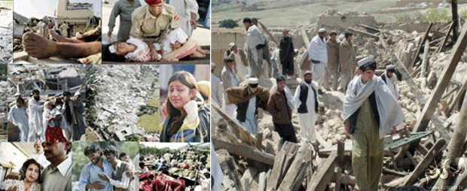
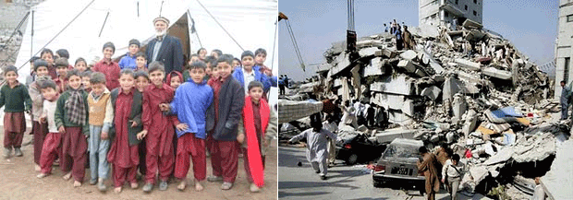
Earthquake 8.9.2005, Balakot Mansehra

Slide 8
The 2005 earthquake was a major earthquake centered in the Pakistan administered Kashmir near the city of Muzaffarabad, also affecting and the Khyber Pakhtunkhwa province of Pakistan.
It occurred at 08:52:37 Pakistan Standard Time on 8 October 2005.
It registered a moment magnitude of 7.6 making it similar in size to the 1906 San Francisco earthquake, the 1935 Quetta earthquake, the 2001 Gujarat earthquake, and the 2009 Sumatra earthquakes.
As of 8 November, the government of Pakistan's official death toll was 75,000.

Slide 9
The earthquake also affected countries in the surrounding region where tremors were felt in Tajikistan and western China, while officials say nearly 1,400 people also died in Jammu and Kashmir and four people in neighboring Nangarhar Province of Afghanistan.

Slide 10
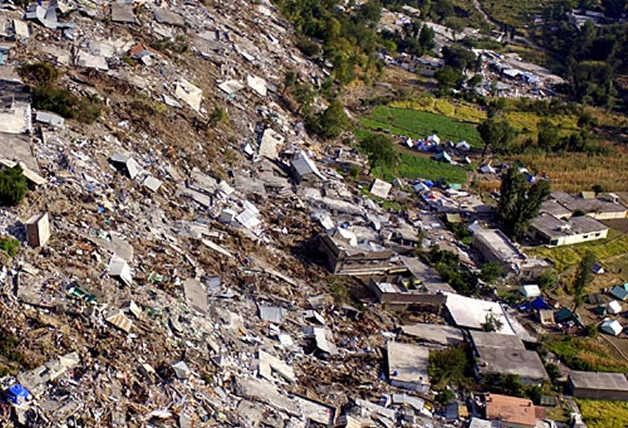
The severity of the damage caused by the earthquake is attributed to severe upthrust, coupled with poor construction.

Slide 11
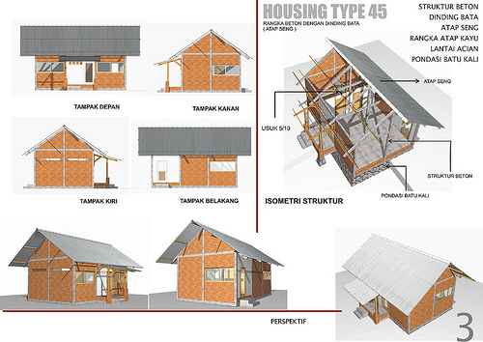
Swiss Agency for Development and Cooperation - SDC

Slide 12
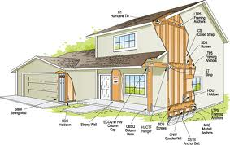
Earthquake Proof House Design

Slide 13
How do you make people learn to build the new earthquake proof houses?
People don’t have facebook, internet, TV etc.

Slide 14
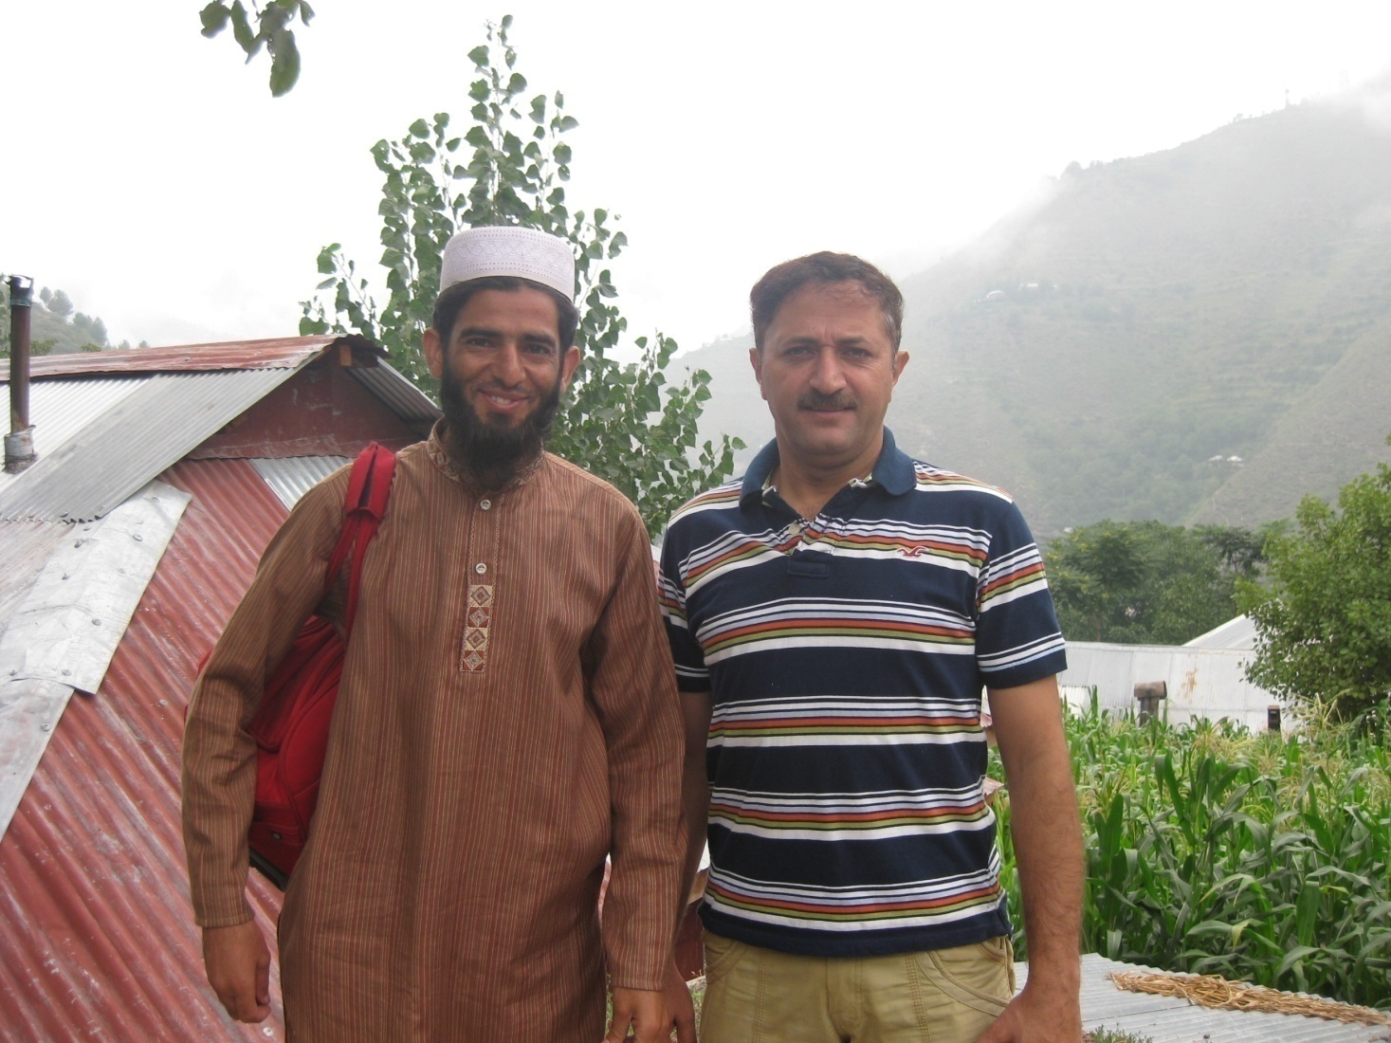
M. Kamran, Manager SDC, Mansehra
Earthquake Proof House
Owner of the House
Kamran

Slide 15
Kamran took the project of building earthquake proof houses in Balakot, Naran etc.
He employed 3 social mobilizers.
The project lasted for three years.
The social mobilizers would go to a village and contact any person.
The social mobilizers would inform him of their visit and project.
The initial contacted person would gather a few other members of his village.
The social mobilizers would again visit the village and present their project to the gathering.

Slide 16
The gathering would select a few memebrs as a village committee.
The SDC social mobilizers would invite the village committee members for the training on Earthquake Proof House building to Base-Camp Mansehra, where an Engineer would give them training on building the house.
It was the job of the village committee to train all other village members in building the eq.p. houses.
On completion of the house along the given guidelines, the family would be given a sum of 3,00,000 Rs/- by ERA (Earthquake Rehabilitation Authority), Government of Pakistan.
Now almost all the villages in the area have safe houses. Their community is a developed community in terms of disasters.

Slide 17
What is Social Mobilization?
Mobilization is a Military terminology
To Mobilize = prepare forces for action
to organize people or resources in order to be ready for action or in order to take action, especially in a military or civil emergency, or to be organized for this purpose.
When Military is mobilized, it is ready to attack the enemy forces at any time.
When community is mobilized, it is ready to attack social problems at any time.

Slide 18
Social Mobilization
Social mobilization is a process of motivating communities to organize in a cohesive group for an active participation towards their own development (Zari Rafiq.p.199).
Mobilization refers to the process of forming crowds, groups, associations and organizations for the pursuit of collective goal (Oberschall A, in Zari Rafiq.p.199).
Social Mobilization means the art or skill of organizing people for some particular objective and leading them to the stage of self-reliance (Ikram Ullah Jan and Abid Ullah Jan, in Zari Rafiq.p.200).

Slide 19
Social Mobility
Movement of a person or persons from one social status to another (Wallace and Wallace)
Vertical Mobility: Change in class, occupation & power position.
Horizontal Mobility: Change in position without a change in status.

Slide 20
Social Movement
Stages:
Preliminary Stage – Unrest
Popular stage – emergence of leader
Formalization stage- party, organization etc
Institutionalization stage
Dissolution stage
Organized group effort to resist or generate social change, or
A collective effort to promote or resist change (Horton & Hunt).
Characteristics:
Collective Action
Oriented towards Social Change
Elements:
Ideology behind the movement
Organizational framework
Consequences

Slide 21
Key Elements of Social Mobilization
Four Key Elements of Social Mobilization
Organizational Development
Capital Formation for Development through Community Savings
Training for Human Resource Development
Socio-Economic Development

Slide 22
1. Organizational Development
It is a process in which community members and, especially the poor, form their own groups or organizations based on common development interests and needs that are best served by organizing themselves as a group.

Slide 23
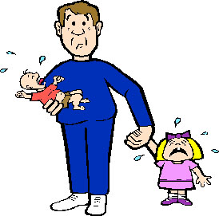
Before a person becomes a member of Community Based Organization (CBO), the individual struggles against harsh conditions.

Slide 24
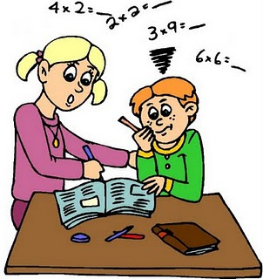
Once he/she is organized in a group or organization, the individual has the leverage (power to get things done) with which to address and tackle problems which he/she could not have done alone (Pandey, 2002).

Slide 25
Types of Community Based Organizations
Specific Focus Organizations
Broad-Based or Multi-purpose organizations

Slide 26
i. CBOs with Specific Focus
E.g.
Earthquake Proof House Building CBOs
Child Protection CBOs
Tenants / Farmers CBOs
Woman Protection CBOs etc etc
Close organizations
Memberships is restricted to a specific category of community members

Slide 27
ii. Multi-Purpose/Broad-based CBOs
Aim to improve the condition the members and the community in which they live.
Holistic focus
More inclusive of poor people
Effective for poverty alleviation, community-wide development and in establishing strong links with local governments (UC Nazims etc)

Slide 28
Factors promoting Effective Organizational Development
Four factors:
Building Democratic principles
Building Leadership capacity of several members
Building Incentives into the early stages
Ensuring inclusive approach

Slide 29
i. Building Democratic Principles
Organization must be run on democratic principles.
It must have a constitution which shall reflect
Its objectives,
Its norms and values,
Its principles by which the CBO will function.
In order to build long-term commitment of members, it is necessary to promote
Norms and values such as tolerance, inclusion, cooperation, and equality
It helps preventing the CBO from diverging into destructing common good.

Slide 30
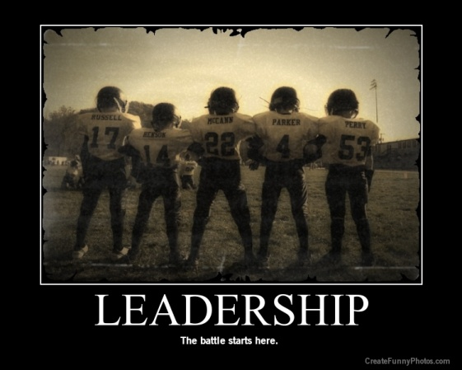
ii. Build Leadership Capacity
Building leadership capacity within the CBO is a must.
Likewise, instead of one individual, leadership capacity of several members must be developed, in order to avoid dependency and capture.
Leadership=ability to lead
Capacity: ability to do something

Slide 31
iii. Building Incentives
Why would you join an organization?
Building incentives into early stages of formation of CBO is necessary because…...
it creates interest among community members for organizing.
Incentive in shape of salary, control over CBOs resources etc.

Slide 32
iv. Inclusive Approach
In order to promote equal opportunities and prevent conflict, a social mobilizer has to adopt inclusive approach – i.e, leave room for new membership.

Slide 33
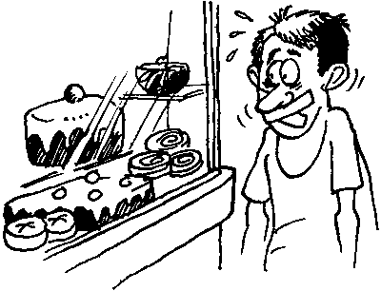
2. Capital Formation for Development Through Community Savings
Capital means “cash for investment.” or
a resource or resources that can be used to generate economic wealth.
Capital Formation means “transfer of savings to businesses.”

Slide 34
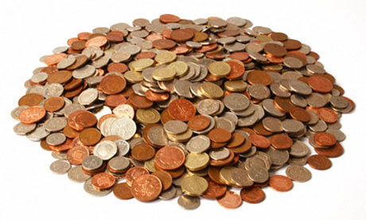
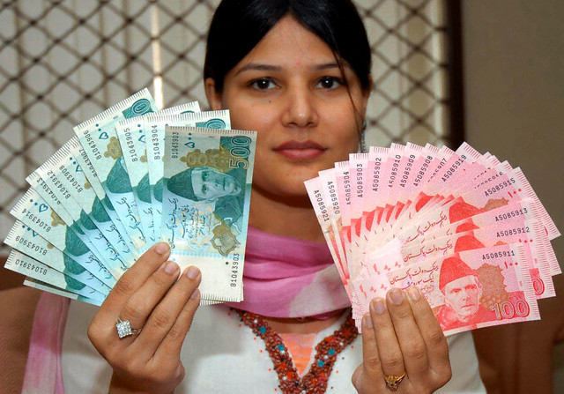
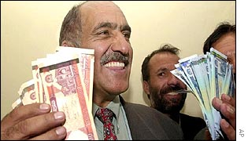
Capital formation through mobilizing of savings enhances a CBOs power to realize its full potential.
Savings generated by individual members are the assets of the CBO and are the first step towards their self-reliance.

Slide 35
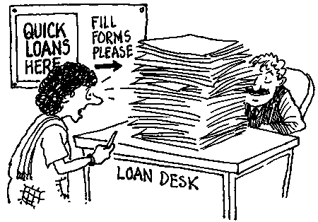
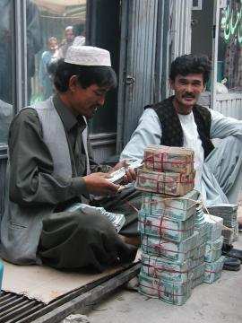
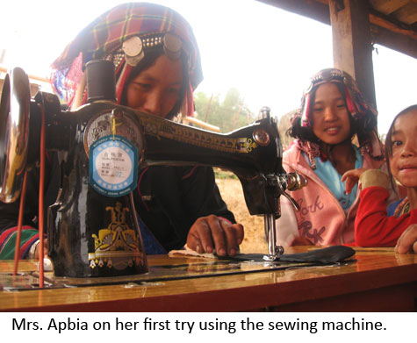
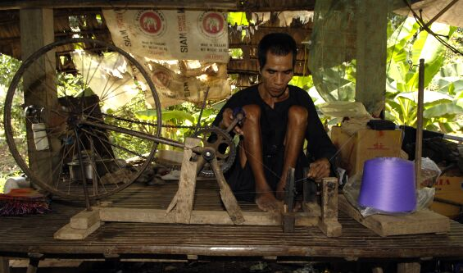
Uses of Capital
CBOs capital can be used for
Internal credit with interest
Enable individual members to engage in income-generation activities
Strengthening CBOs capital base.
Enterprise development at community level
Contribute to local development initiatives
Enterprise: business activities directed at profit

Slide 36
3. Training for Human Resource Development
Resource means “somebody or something that is a source of help or information.”
Human Resources are all the people working within a CBO.

Slide 37
Community members can maximize their potential not only by organizing themselves but also by upgrading their existing skills to better manage new inputs. –e.g new community initiatives, establishing links with local government.

Slide 38
A social mobilizer can support
Direct training,
Exchange visits, and
other capacity building activities based on needs identified by the members of the CBO.

Slide 39
Some of the key skills might include,
advocacy skills,
accounting,
record keeping,
village profiling,
networking,
fundraising,
Organizational development,
Leadership skills,
Natural resource management skills, etc.

Slide 40
For better human resource development, it is essential that trained individuals take-up the responsibility to train other community memebrs.

